Slide 1
Flow Design Menus

Slide 2
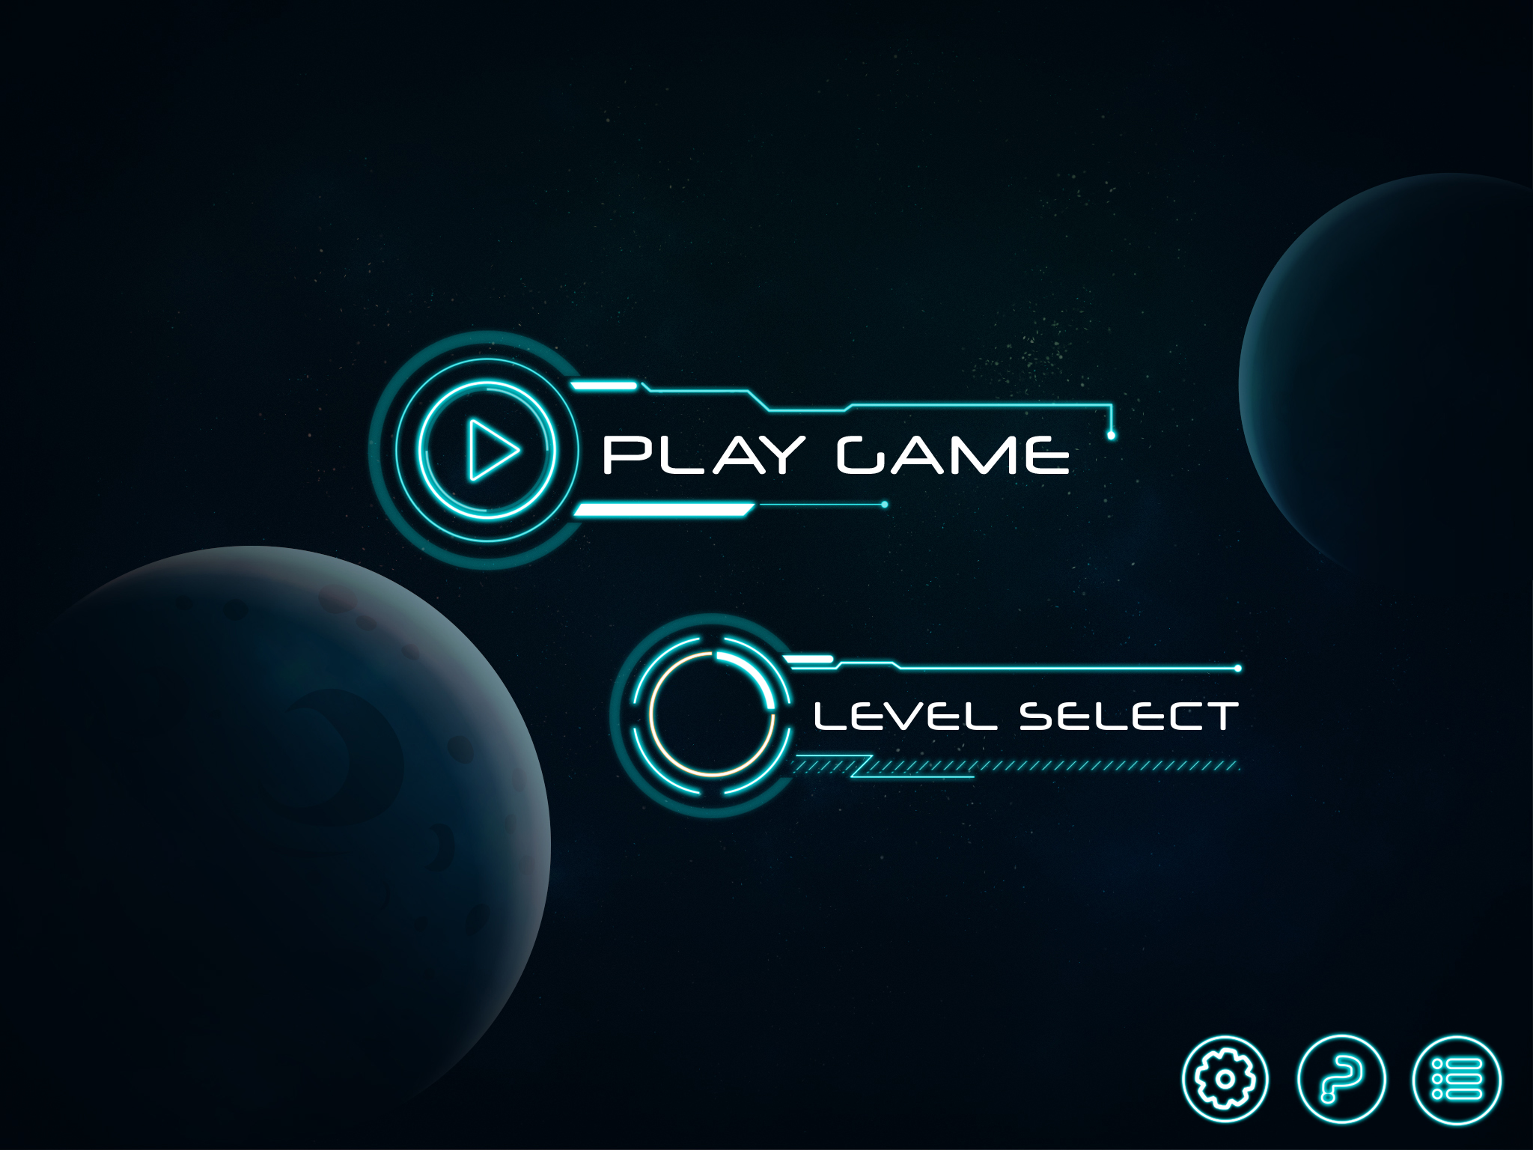
Start menu
When the player opens up our game they will come onto this screen. When they press play they will proceed to the game screen where they can start playing the game.
They can also select the settings button which will bring them to the settings screen.
They can also select the instructions button. This will then bring them to the instructions screen.

Slide 3

Play Icon
This is the play button for our game. Players will encounter this when they are on the pause menu. When they select this the current game will resume onto the game screen.

Slide 4
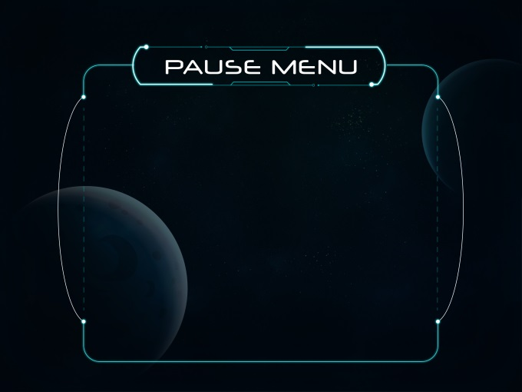
Pause Menu
This is our pause menu. Players will encounter this when they press the pause button on the game screen, on the pause screen they can then select the play, settings or quit button.
The play button will resume the game
The settings button will bring the player to the settings screen
The quit button will bring the player back to the menu screen.

Slide 5

Settings Icon
This is the settings button for our game. players will encounter this on the main menu and the pause menu. When the players select this they will then be directed to the settings screen

Slide 6
Settings Menu
In the setting's screen the players can change:
Volume of the sound
Brightness of the screen
Sensitivity of the players spaceships
Screen size of the game
Quality of the image

